Slide 1


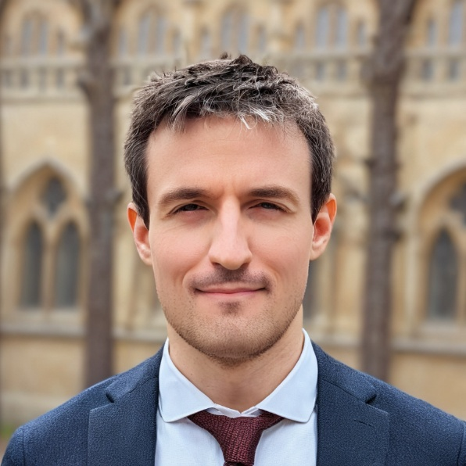
Starting Now
Why Post-Training Is the Real Key to Powerful LLMs
Supervised Fine-Tuning Direct Preference Optimization Reinforcement Learning (GRPO)
Maxime Labonne
Head of Post-Training, Liquid AI

Slide 2

Why Post-Training Is the Real Key to Powerful LLMs
Maxime Labonne

Slide 3
About Maxime Labonne
💼 PhD, Head of Post-Training @ Liquid AI, GDE
📙 Author of the LLM Engineer’s Handbook
📝 Writing: Blog posts, LLM Course (>56k⭐ on GitHub)
🤗 Models: NeuralDaredevil, AlphaMonarch, Phixtral
⚙️ Tools: LLM AutoEval, LazyMergekit, AutoQuant
Maxime Labonne
Head of Post-Training, Liquid AI
Notes:
0

Slide 4
Agenda
01
What is post-training?
02
Supervised Fine-Tuning
03
Direct Preference Optimization
04
Reinforcement Learning (GRPO)
05
Conclusion

Slide 5
What is post-training?

Slide 6
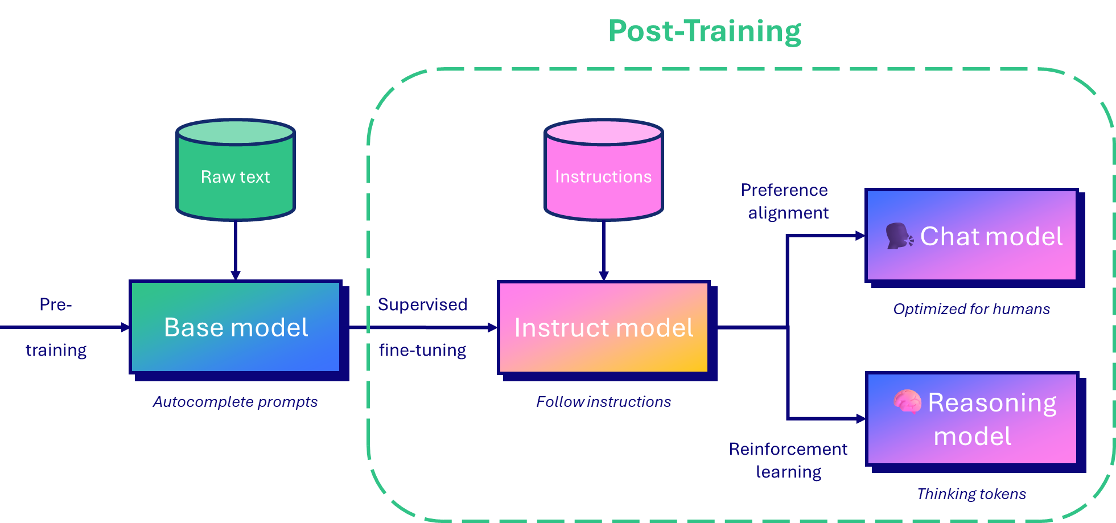
What is post-training?
Pg: 6
>

Slide 7
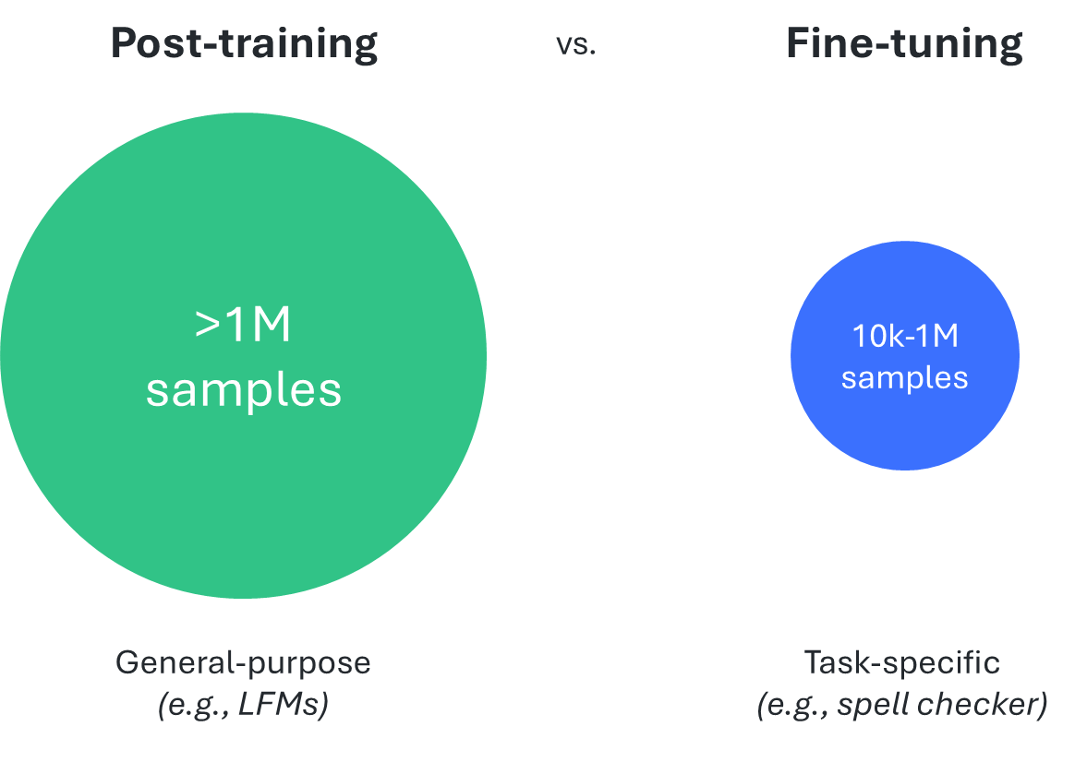
What is post-training?
>
Pg: 7

Slide 8
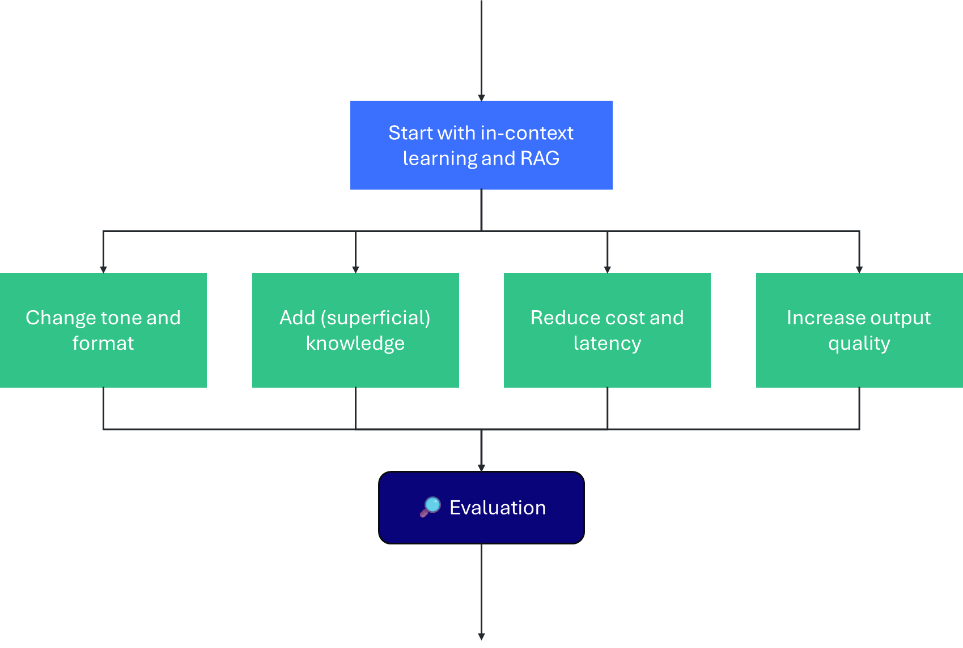
What is post-training?
>
Pg: 8

Slide 9




What is post-training?
Let’s pick a model to post-train…
Qwen
LFM2
Gemma
Llama
Pg: 9
>

Slide 10
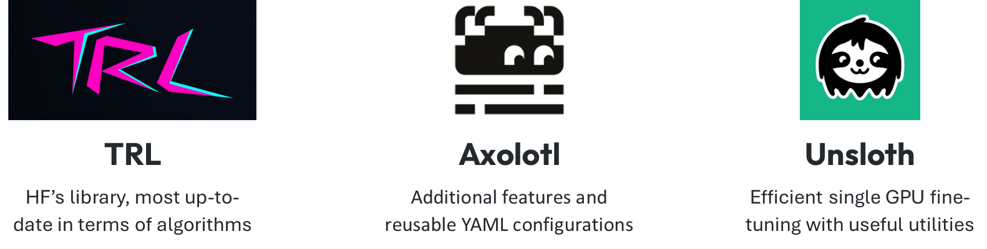
What is post-training?
… and a library to train it
>
Pg: 10

Slide 11



What is post-training?
Hardware requirements
Google Colab
Cloud GPUs
Local GPUs
User-friendly and cheap, for quick experiments
More scalable, cheaper for longer runs
Expensive but unlimited use after purchase
>
Pg: 11

Slide 12
Supervised Fine-Tuning

Slide 13
Supervised Fine-Tuning
Instruction data
System (optional) You are a helpful assistant.
User Remove the spaces from the following sentence: Fine-tuning is simple.
Assistant Fine-tuningissimple.
Context
Training
>
Pg: 13

Slide 14
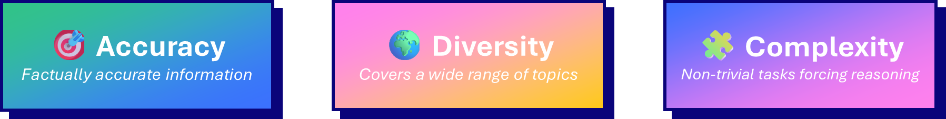
Supervised Fine-Tuning
What is a good dataset?
>
Pg: 14

Slide 15
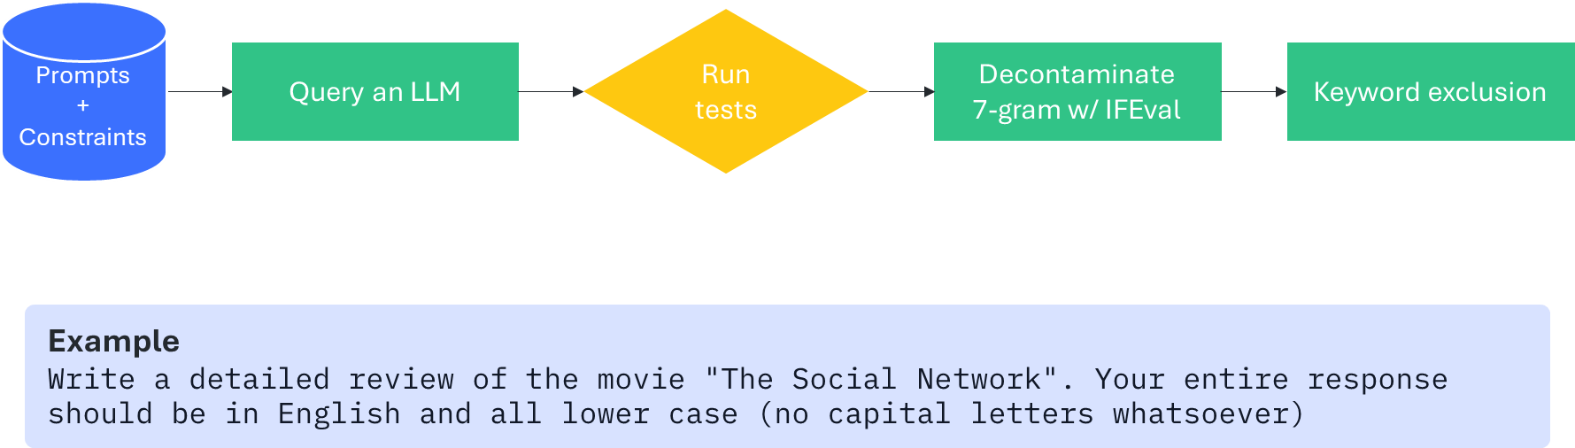
Supervised Fine-Tuning
Data generation
Example: Instruction following
>
Pg: 15

Slide 16
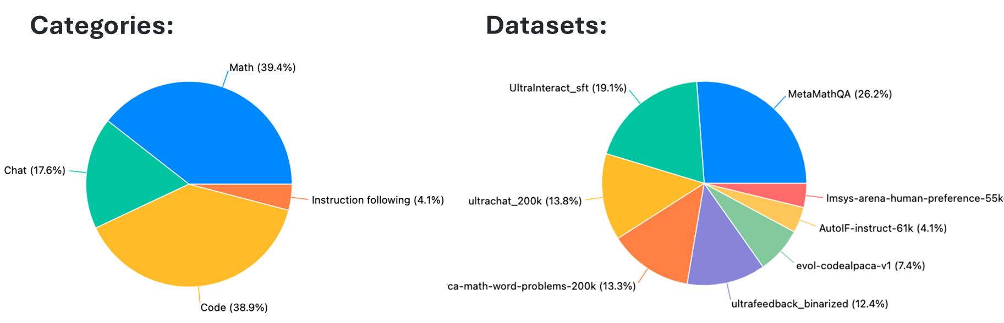
Supervised Fine-Tuning
Dataset creation
🎨 Example: mlabonne/open-perfectblend
>
Pg: 16
Tengyu Xu et al. "The Perfect Blend: Redefining RLHF with Mixture of Judges." arXiv preprint arXiv:2409.20370, September 2024.

Slide 17
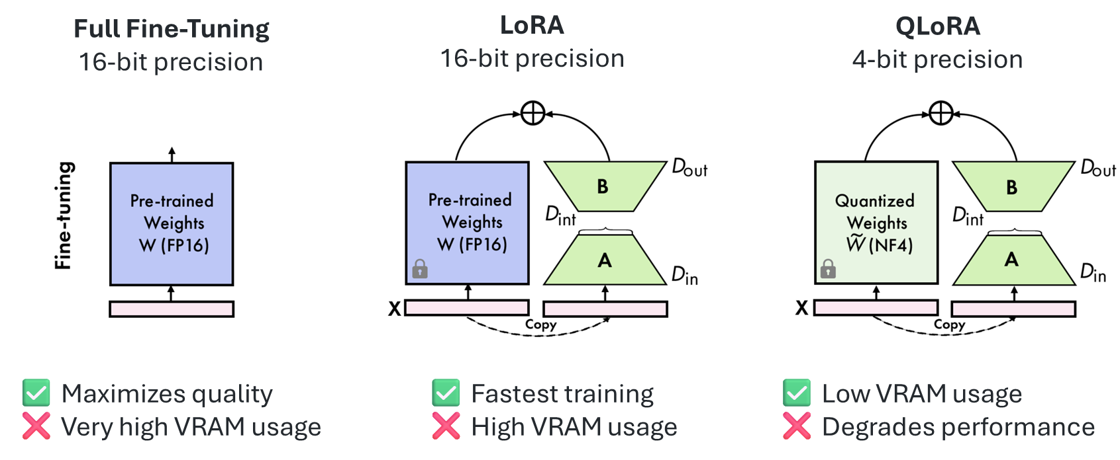
Supervised Fine-Tuning
SFT techniques
>
Pg: 17
Figure adapted from Xu, Yuhui, et al. "QA-LoRA: Quantization-Aware Low-Rank Adaptation of Large Language Models." arXiv preprint arXiv:2309.14717 (2023).

Slide 18
Supervised Fine-Tuning
Training parameters
Parameter | Description | Common values
📉 Learning rate | Strength of the parameter update | 1e-6 to 1e-3
🔢 Epochs | Number of passes over the dataset | 2 to 5
2️⃣ Batch size | Number of samples before parameter update | 8 or 16 (effective)
📏 Max length | Longest input (in tokens) | 1k to 32k
🧠 Optimizer | Algorithm for the parameter update | AdamW
👀 Attention | Implementation of the attention mechanism | FlashAttention
Quality
Memory
Don’t touch!
>
Pg: 18

Slide 19
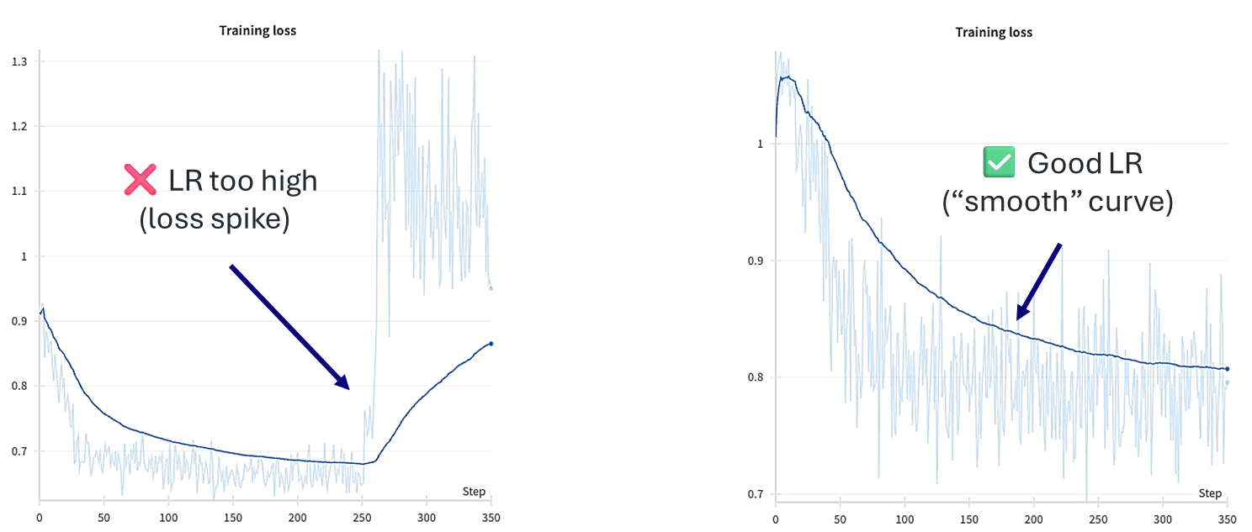
Supervised Fine-Tuning
Monitoring experiments
>
Pg: 19

Slide 20
Supervised Fine-Tuning
Evaluation
Pre-training benchmarks
+
SFT benchmarks
Token log probabilities / few-shot
Generated answers
MMLU (knowledge)
GSM8K (math)
LiveCodeBench v5 (code)
BFCL v3 (function calling)
MMMLU (multilingual)
IFEval (instruction following)
>
Pg: 20

Slide 21
Direct Preference Optimization

Slide 22
Direct Preference Optimization
Preference data
System (optional) You are a helpful assistant with a great sense of humor.
Instruction Tell me a joke about octopuses.
Chosen answer Why don't octopuses play cards in casinos? Because they can't count past eight. | Rejected answer How many tickles does it take to make an octopus laugh? Ten tickles.
Context
Training
>
Pg: 22

Slide 23
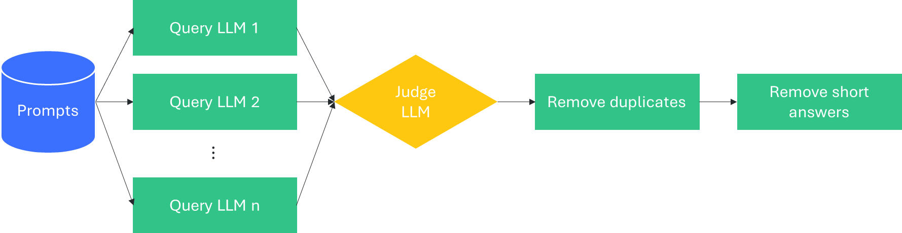
Direct Preference Optimization
Data generation
Example: Instruction following
>
Pg: 23
Ganqu Cui et al. "UltraFeedback: Boosting Language Models with Scaled AI Feedback." arXiv preprint arXiv:2310.01377, October 2023.

Slide 24
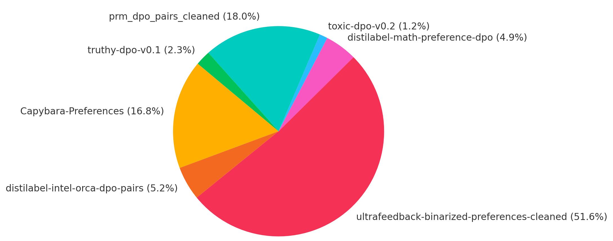
Direct Preference Optimization
Dataset creation
🐋 Example: mlabonne/orpo-dpo-mix-40k
Scoring: keep highly scored chosen answers
Rule-based filtering: remove “gptisms” in chosen answers
Most popular preference dataset on Hugging Face ♥
>
Pg: 24

Slide 25
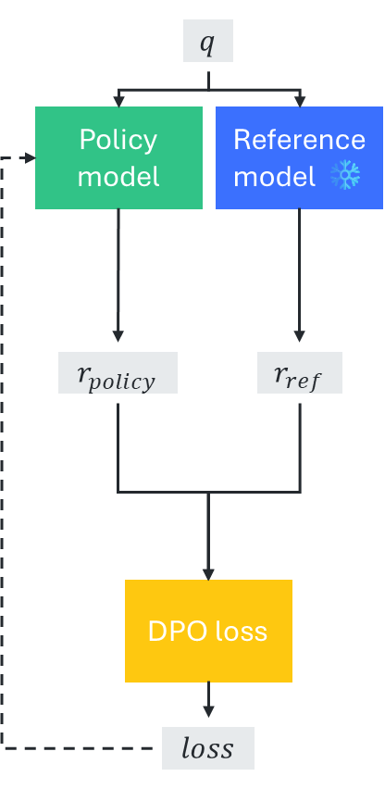
Direct Preference Optimization
Direct Preference Optimization
Reference model
Provides baseline probability estimates
Log-probability ratios
Compares policy vs. reference model log-probabilities for chosen/rejected answers
Bradley-Terry loss
Optimizes sigmoid of log-prob differences to match human preferences
>
Pg: 25
Notes:
Reference model: DPO begins with a frozen reference model (typically an SFT model) that serves as an anchor point. This model remains unchanged throughout training and provides baseline probability estimates for all generated responses. The policy model is initialized from the same checkpoint as the reference model.
Log-probability ratios: For each training example (containing a chosen and a rejected answer), both the policy model and reference model compute log-probabilities for generating each complete response sequence. The key insight is computing the ratio of these probabilities - specifically, log(π_policy/π_reference) for both the chosen and rejected answers. This ratio captures how much the policy model's preferences have shifted relative to the reference.
Bradley-Terry loss: The DPO loss function applies the Bradley-Terry model using a sigmoid over the difference in log-probability ratios: L = -log(σ(β[log(π_θ(y_chosen)/π_ref(y_chosen)) - log(π_θ(y_rejected)/π_ref(y_rejected))])). The β parameter controls the strength of the preference signal. This loss directly optimizes the policy model to increase the likelihood of preferred responses while decreasing the likelihood of rejected ones, with the reference model providing implicit KL regularization to prevent the policy from deviating too drastically.

Slide 26
Direct Preference Optimization
Training parameters
Parameter | Description | Common values
🅱️ Beta | Importance of the new policy | 0.1 to 0.5
📉 Learning rate | Strength of the parameter update | 1e-7 to 1e-4
🔢 Epochs | Number of passes over the dataset | 2 to 5
2️⃣ Batch size | Number of samples before parameter update | 8 or 16 (effective)
📏 Max length | Longest input (in tokens) | 1k to 32k
Quality
Memory
>
Pg: 26

Slide 27
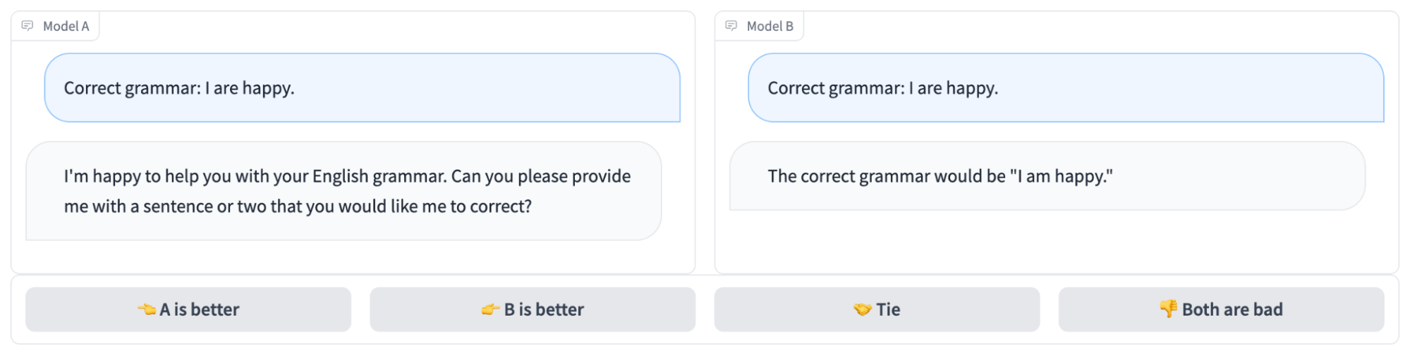
Direct Preference Optimization
Evaluation
🧑 or 🤖
>
Pg: 27

Slide 28
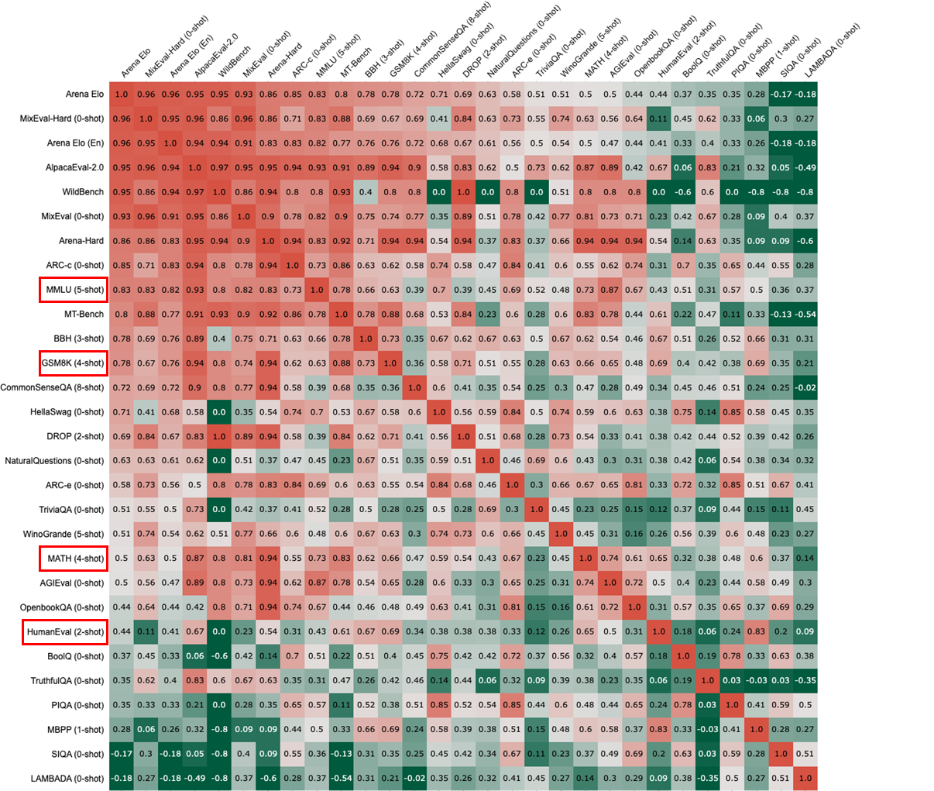
Direct Preference Optimization
Evaluation
Human preferences are weakly correlated with automated benchmarks
>
Pg: 28
Jinjie Ni et al. "MixEval: Deriving Wisdom of the Crowd from LLM Benchmark Mixtures." arXiv preprint arXiv:2406.06565, June 2024.

Slide 29
Reinforcement Learning (GRPO)

Slide 30
Reinforcement Learning (GRPO)
Reasoning data
System (optional) Think step by step and write the final answer in \boxed{}.
User Simplify the expression $cos^2(x) - sin^2(x)$.
Assistant <think> Okay, I need to…</think> The answer is \boxed{\cos(2x)}.
System (optional) Think step by step and write the final answer in \boxed{}.
User Simplify the expression $cos^2(x) - sin^2(x)$.
Ground-truth \cos(2x)
Instruction data
RL data
>
Pg: 30

Slide 31
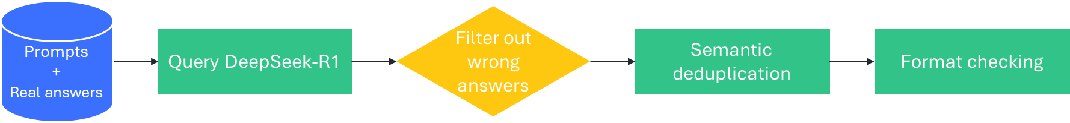
Reinforcement Learning (GRPO)
Data generation
Example: Reasoning data (offline distillation)
>
Pg: 31

Slide 32
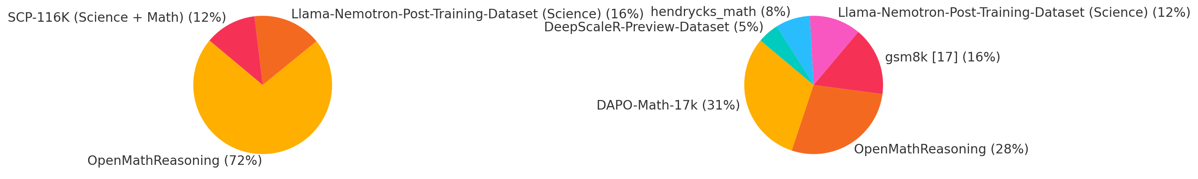
Reinforcement Learning (GRPO)
Dataset creation
🧮 Example: LFM-1B-Math
Instruction dataset:
RL dataset:
>
Pg: 32
Seyde et al. “LFM-1B-Math: Can Small Models Be Concise Reasoners?" liquid.ai/research/lfm-1b-math-can-small-models-be-concise-reasoners, June 2025.

Slide 33
Reinforcement Learning (GRPO)
Reward functions
Example: Summarization model
def reward_len(answer, **kwargs):
return [-abs(50 - len(answer)) for answer in answers]
🎯 Reward the model if the answer is about 50 characters
>
Pg: 33

Slide 34
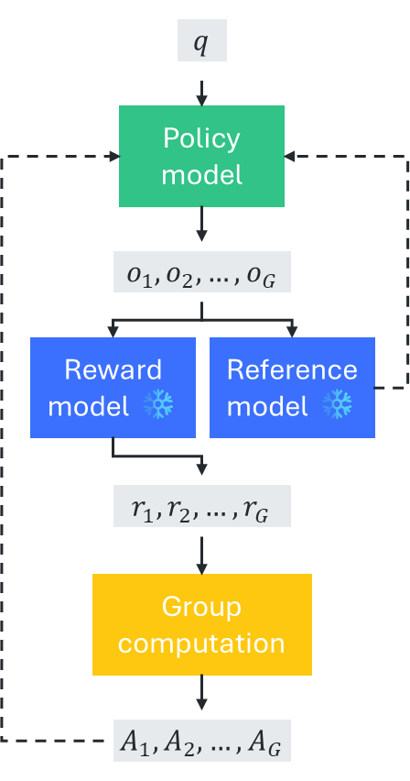
Reinforcement Learning (GRPO)
GRPO
Reference model
Provides baseline probability estimates
Log-probability ratios
Compares policy vs. reference model log-probabilities for chosen/rejected answers
Bradley-Terry loss
Optimizes sigmoid of log-prob differences to match human preferences
>
Pg: 34

Slide 35
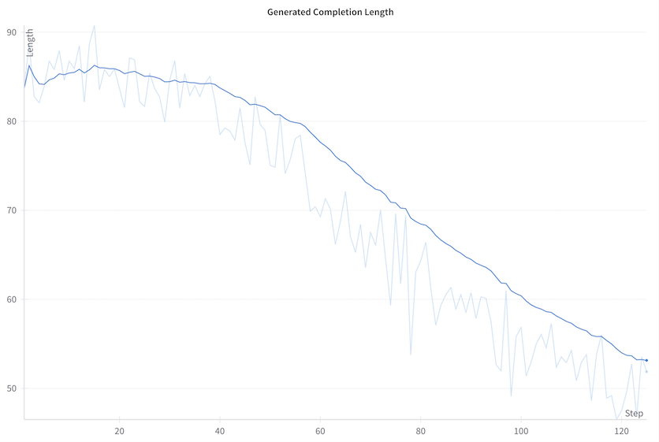
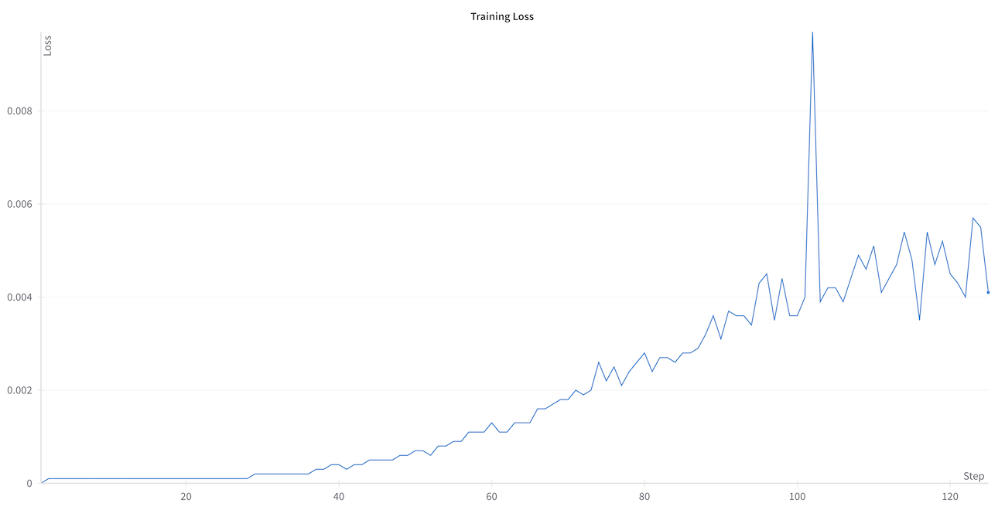
Reinforcement Learning (GRPO)
Reward functions
Example: Summarization model
Length goes down, loss goes up (counter-intuitive but expected)
>
Pg: 35

Slide 36
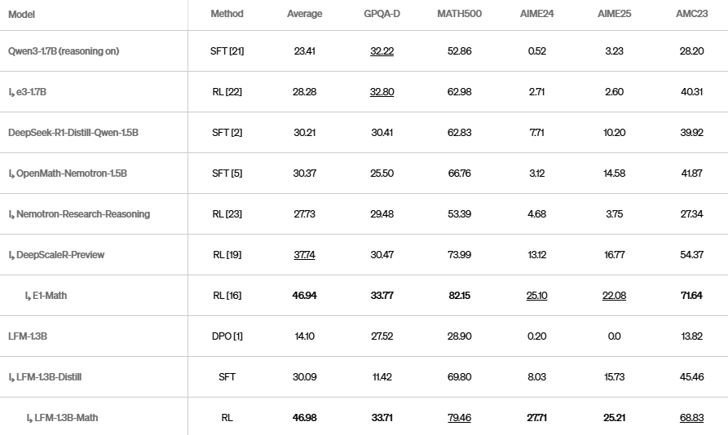
Reinforcement Learning (GRPO)
Evaluation
Automated math & code benchmarks from competitions
>
Pg: 36
Seyde et al. “LFM-1B-Math: Can Small Models Be Concise Reasoners?" liquid.ai/research/lfm-1b-math-can-small-models-be-concise-reasoners, June 2025.

Slide 37
Conclusion

Slide 38
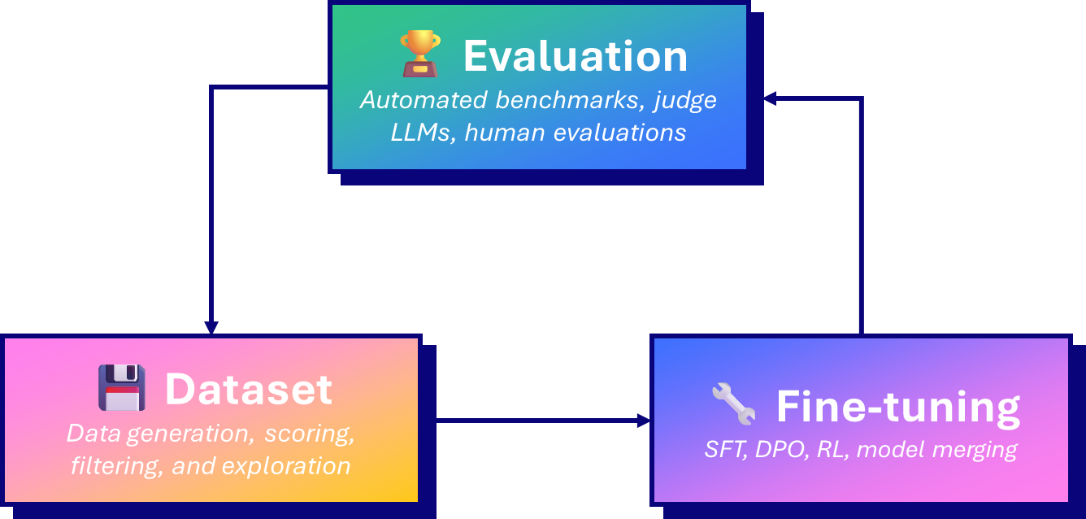
Conclusion
>
Pg: 38

Slide 39
Thank You

